Slide 1
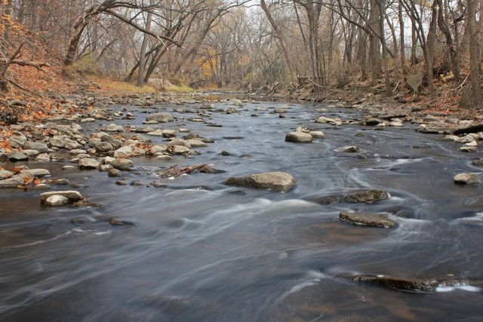
Menomonee River Fish Sampling
Steve Van Alstine, Chris Manteufel, Tommy Jones, Travis Brunner, Kathryn Leistekow

Slide 2
Introduction and Background Information
Menomonee River
Tributary to the Milwaukee River which eventually flows into Lake Michigan
Used for docking and shipping in the Menomonee Valley
Flashy flow pattern

Slide 3
Introduction and Background Information
Pollution has been measured in the past
Similar methods have been used by WLC students in the past
Testing is done twice annually (once in the fall and once in the spring)

Slide 4
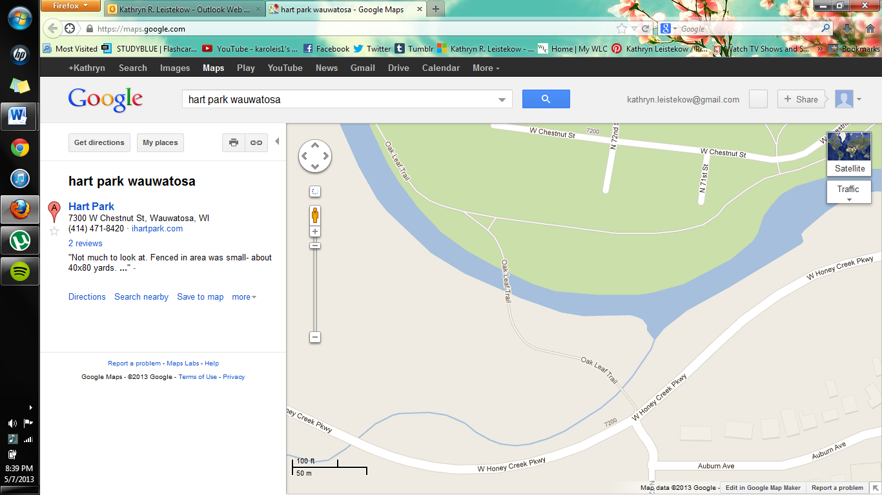

Slide 5
Materials and Methods
Ideal size of sampling: 9 meters by 315 meters
Electroshocking
Barge
Nets
Classification
DELTs

Slide 6
Results
Collected Sample
Common Name | Total | Length Interval | Number In Length | DELTS
Black Nose Dace | 17 | 30-69 70-100 | 16 1 | 0 0
Calculated IBI from River Sampling
MSR # of species | MSR # of intolerant | % tolerant species | % omnivores | % insectivores | % top carnivores | % simple lithophils | Total MSR | Correction Factors | Net MSR | Condition
0 | 0 | 0 | 10 | 10 | 0 | 10 | 30 | -10 | 20 | Poor

Slide 7
Discussion
Shocking Equipment did not function, so we were unable to collect results from electroshocking
Since there was few fish collected, we were unable to determine the actual IBI number
Minimum of 50 fish are needed
Only 17 were caught
All species caught were Blacknose Dace, which are a tolerant species

Slide 8
Discussion (cont.)
According to the data we were able to collect, the health of the river was very poor
We found no diversity with the results that we collected
One species found was tolerant
Found below 50 fish, therefore the catch rate determines quality to be very poor

Slide 9
Reasons for Error
Nonfunctioning Shocking Equipment
Flooding
Daniel Lyons states:
Sampling should take place between mid-June and mid-September
Sampling should also be avoided for at least 2 weeks after a major flood, even if water levels quickly return to normal.

Slide 10
Conclusion

Slide 11
Sources

